Slide 1

ASEN 5070
Statistical Orbit determination I
Fall 2012
Professor George H. Born
Professor Jeffrey S. Parker
Lecture 7: Spaceflight Ops and Statistics

Slide 2
Announcements
Homework 1 Graded
Comments included on D2L
Any questions, talk with us this week
Homework 2 CAETE due Thursday
Graded soon after
Homework 3 due Thursday
Homework 4 out today

Slide 3
Lecture Plan
Review Homework and Quizzes
Finish Mars Odyssey
Review Statistics
Start on some serious Stat OD!

Slide 4
Homework 3
Questions yet?

Slide 5
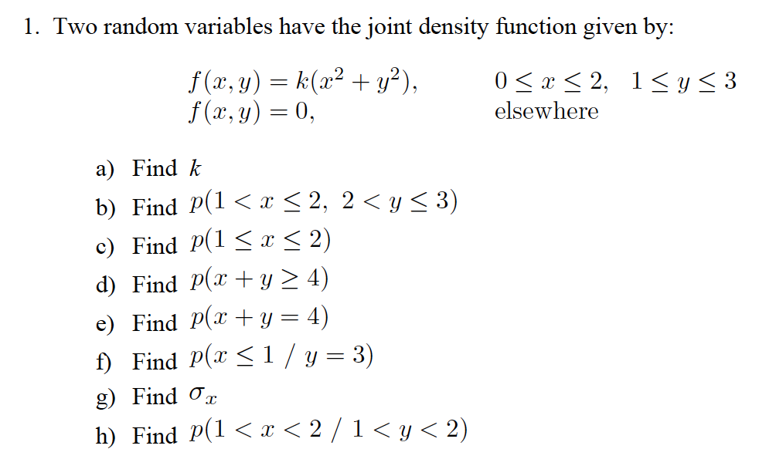
Homework 4

Slide 6
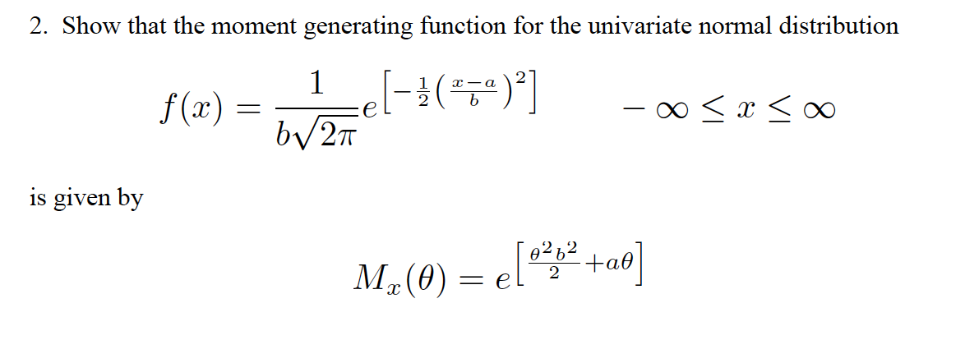
Homework 4

Slide 7
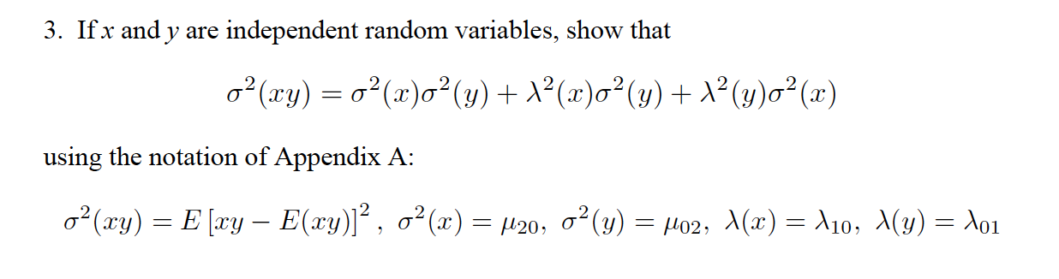
Homework 4

Slide 8
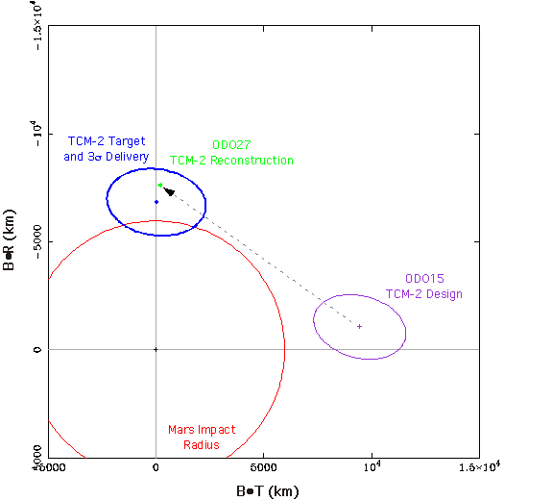
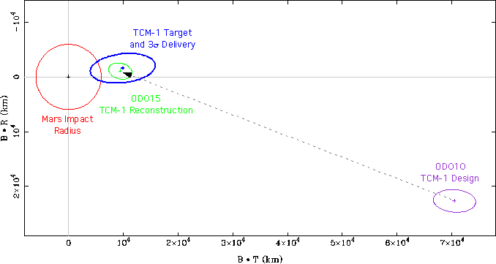
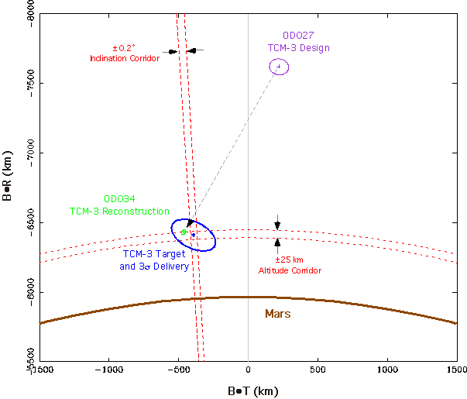
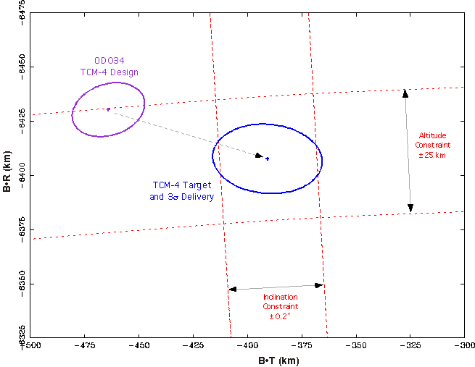
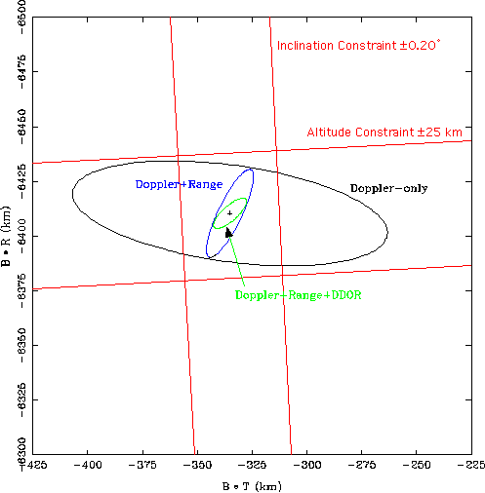
Mars Odyssey

Slide 9
Mars Odyssey

Slide 10
Aerobraking Nav Prediction Accuracy
Requirement
Must predict Periapsis Time to within 225 sec
Must predict Periapsis Altitude to within 1.5 km
Capability
Altitude requirement easily met with MGS gravity field (Nav Plan)
Timing requirement uncertainty dominated by assumption on future drag pass atmospheric uncertainty
Atmospheric Variability
Total Orbit-to-Orbit Atmospheric variability: 80% (MGS: 90%)
Periapsis timing prediction
To first order, the expected change in orbit period per drag pass will indicate how well future periapses can be predicted
This simplifying assumption is supported by OD covariance analysis

Slide 11
Nav Predict Capability
Example
Total expected Period change for a given drag pass is 1000 seconds
Atmosphere could change density by 80%
Resulting Period change could be off by 80% = 800 sec
If orbit Period is different by 800 seconds, then the time of the next periapsis will be different by 800 seconds
This fails to meet the 225 sec requirement
Large Period Orbits
Period change per rev is large
Therefore can never predict more than 1 periapsis ahead within the 225 sec requirement with any confidence
Small Period Orbits
Period change per rev is small (for example 30 seconds)
Therefore can predict several periapses in the future to within the 225 second requirement
Example: 80% uncertainty (24 sec) will allow a 9 rev predict

Slide 12
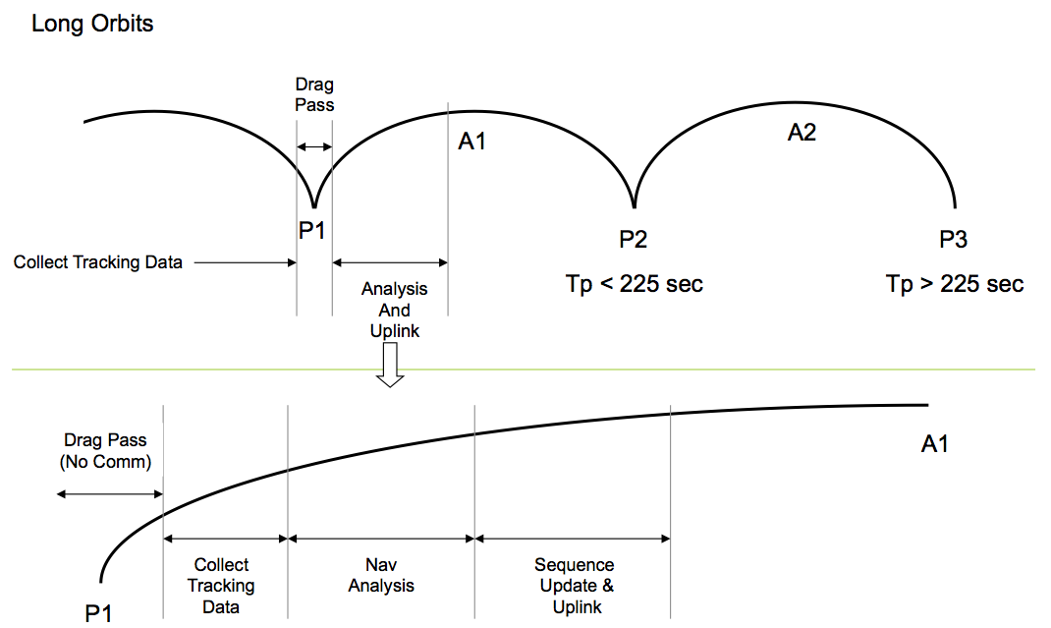
Aerobraking Navigation Process

Slide 13
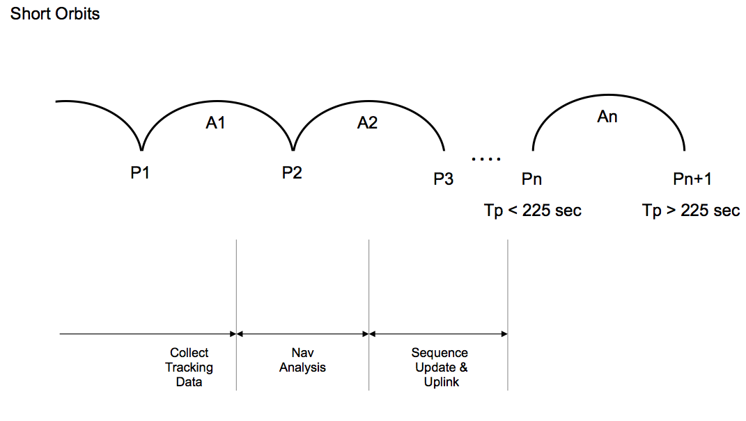
Aerobraking Navigation Process

Slide 14
What contributed to ODY success?
A Baseline set of Navigation solution strategies were identified
Varied data arcs, data types, data weights, parameter estimates, a-prioris
These solutions were regularly performed and trended
Built a time history of trajectory solutions
Trended evolution of parameter estimates and encounter conditions
Lessons learned from MCO and MPL
Regularly demonstrate consistency to Project and NAG
Weekly Status Reports
Daily Status after TCM-4 (MOI-12 days) “Daily Show”
Shadow navigators
Independent solutions run by Sec312 personnel (Bhaskaran, Portock)

Slide 15
Mars Odyssey
Questions
Quick Break
Next up:
Statistics
Stat OD

Slide 16
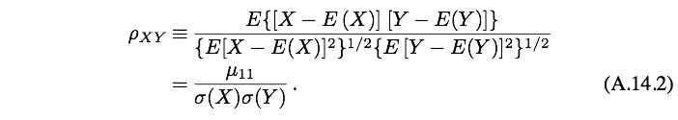
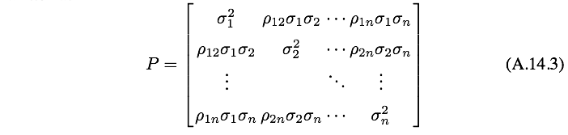
The Variance-Covariance Matrix

Slide 17
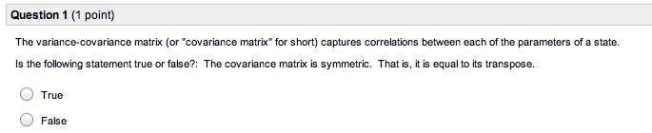
Quiz #5 Results

Slide 18
Quiz #5 Results

Slide 19
The Variance-Covariance Matrix

Slide 20
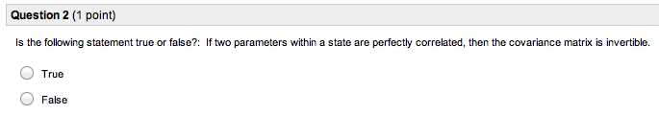
Quiz #5 Results

Slide 21
Quiz #5 Results

Slide 22
The Variance-Covariance Matrix
If two parameters are perfectly correlated then
Say we have and all other correlations are 0.

Slide 23
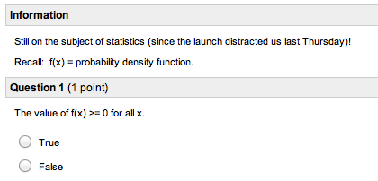
Quiz #6 Results

Slide 24
Quiz #6 Results

Slide 25
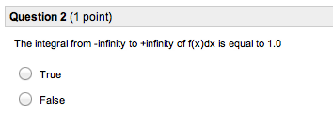
Quiz #6 Results

Slide 26
Quiz #6 Results
The probability of sampling a distribution and getting something is equal to 100%

Slide 27
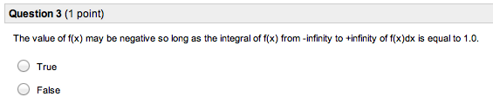
Quiz #6 Results

Slide 28
Quiz #6 Results

Slide 29
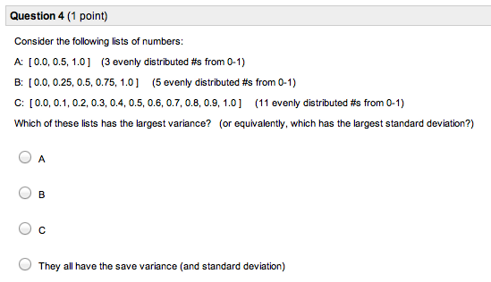
Quiz #6 Results

Slide 30
Quiz #6 Results

Slide 31
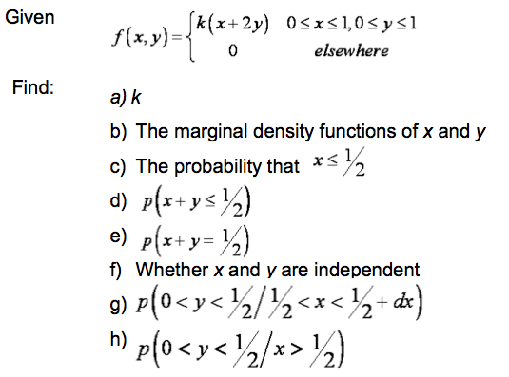
Example Problems in Statistics

Slide 32
Example Problems in Statistics
f = joint density function

Slide 33
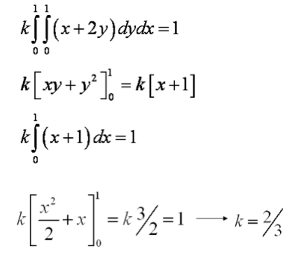
Example Problems in Statistics
f = joint density function

Slide 34
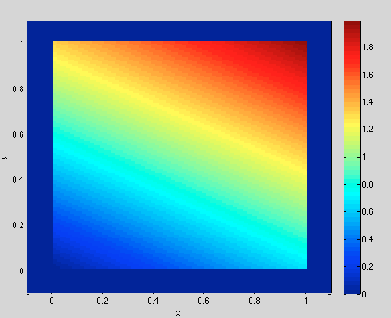
Example Problems in Statistics

Slide 35
Example Problems in Statistics
What is the marginal density function of x? What does that mean?

Slide 36
Example Problems in Statistics
What is the marginal density function of x? What does that mean?
The marginal density function of x is the probability density function of x in the presence of any y.

Slide 37
Example Problems in Statistics
We’ll work this one
You’ll work this one

Slide 38
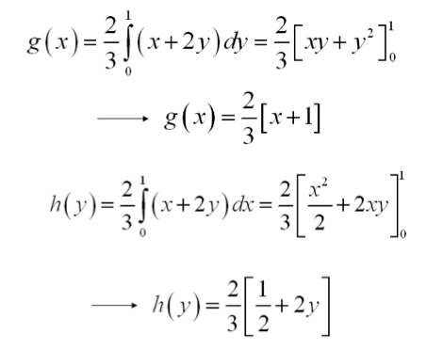
Example Problems in Statistics

Slide 39
Example Problems in Statistics
???

Slide 40
Example Problems in Statistics

Slide 41
Example Problems in Statistics

Slide 42
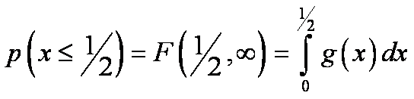
Example Problems in Statistics

Slide 43
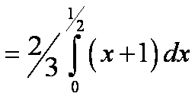
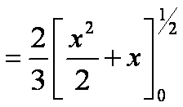
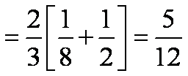
Example Problems in Statistics

Slide 44
Example Problems in Statistics

Slide 45
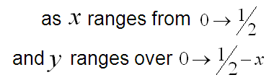
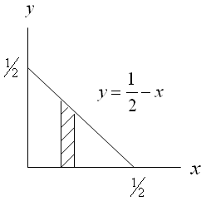
Example Problems in Statistics

Slide 46

Example Problems in Statistics

Slide 47


Example Problems in Statistics

Slide 48
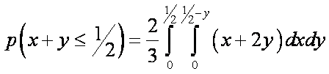

Example Problems in Statistics
also,
and,

Slide 49
Example Problems in Statistics

Slide 50

Example Problems in Statistics

Slide 51
Example Problems in Statistics

Slide 52
Example Problems in Statistics

Slide 53
Example Problems in Statistics

Slide 54
Example Problems in Statistics

Slide 55
Example Problems in Statistics

Slide 56
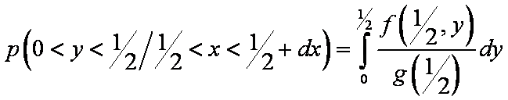
Example Problems in Statistics

Slide 57
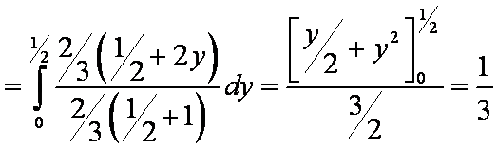
Example Problems in Statistics

Slide 58
Example Problems in Statistics

Slide 59
Example Problems in Statistics

Slide 60
Example Problems in Statistics

Slide 61
Example Problems in Statistics

Slide 62
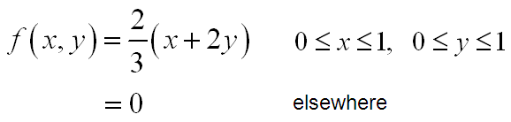
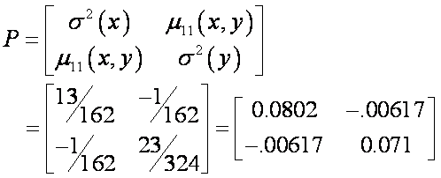

Example Problem continued
Determine the Variance-Covariance matrix for the example problem

Slide 63
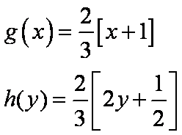
Example Problem continued
Determine the Variance-Covariance matrix for the example problem
We have shown that the marginal density functions are given by

Slide 64


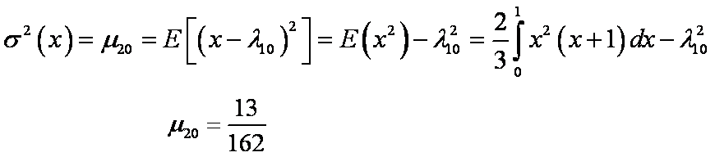
Example Problem continued
The elements of the variance-covariance matrix are computed below

Slide 65


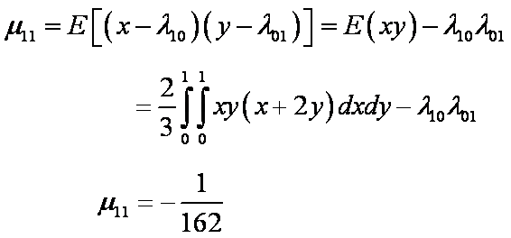
Example Problem continued
Cont.

Slide 66
Example Problem continued
The variance-covariance matrix, P, is given by
The correlation coefficient for random variables x and y is given by

Slide 67

Example Problem continued
The variance-covariance matrix, P, is given by
The correlation coefficient for random variables x and y is given by
A common OD expression for the variance-covariance matrix has variances on the diagonal, covariance's in the upper triangle and correlation coefficients in the lower triangle.
Hence,

Slide 68
Statistical Problems
Questions?
One last quick subject:
Distributions with multiple variables that are Gaussian in any combination of those variables

Slide 69
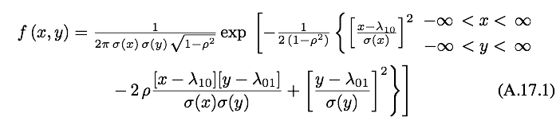

Bivariate Normal Distribution

Slide 70
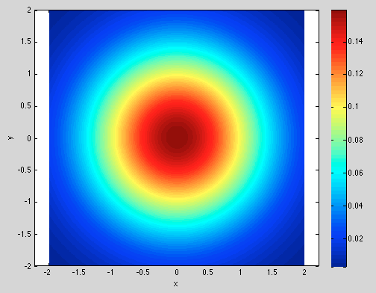
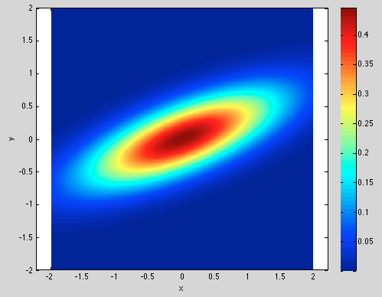
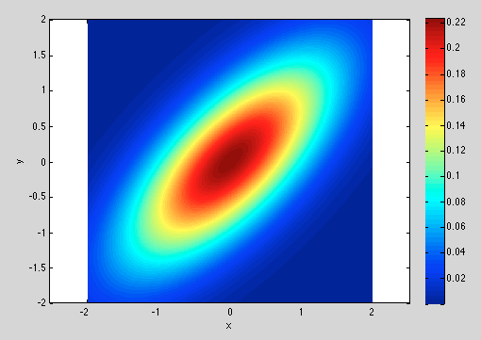
Bivariate Normal Distribution

Slide 71


Marginal Density Function

Slide 72


Conditional Density Function

Slide 73
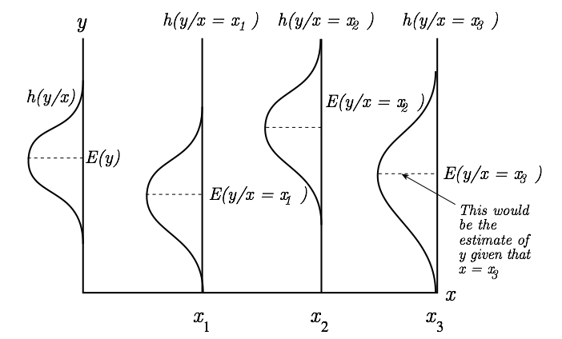
Conditional Density Function

Slide 74

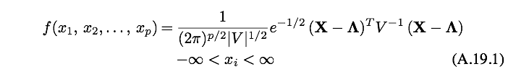
The Multivariate Normal Distribution

Slide 75
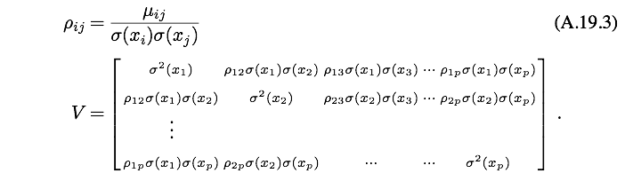
The Multivariate Normal Distribution

Slide 76
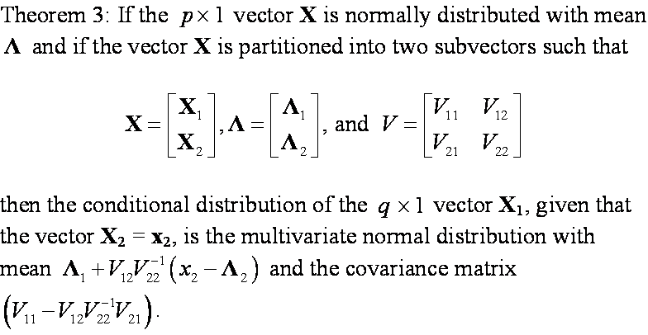
Conditional Distribution for Multivariate Normal Variables

Slide 77
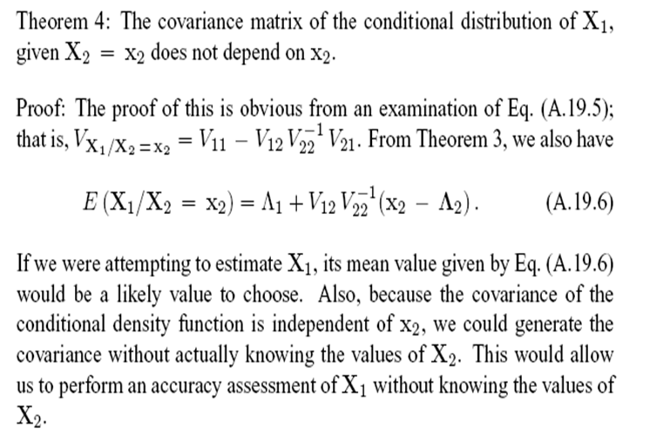

Slide 78
Final Statements
Homework 1 Graded
Comments included on D2L
Any questions, talk with us this week
Homework 2 CAETE due Thursday
Graded soon after
Homework 3 due Thursday
Homework 4 out today
Quiz available tomorrow at 1pm

